Slide 1
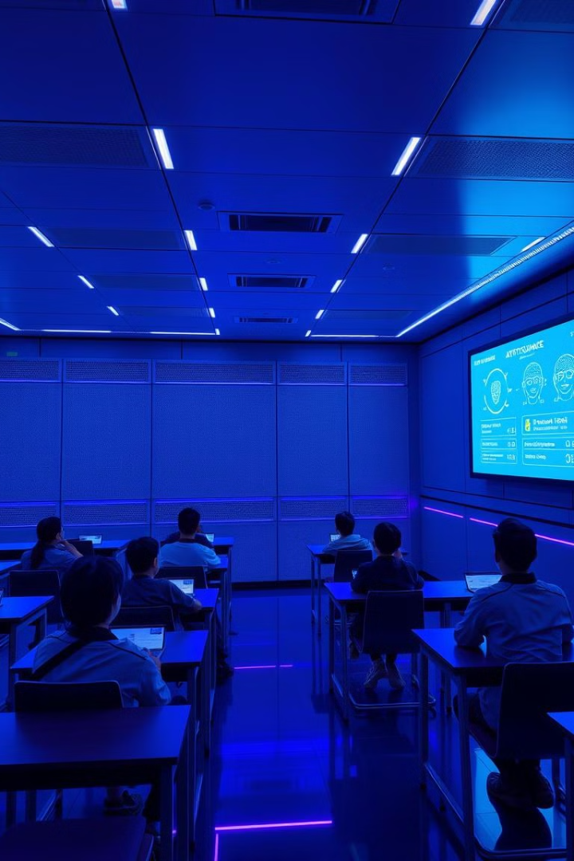
AI-Powered Student Attendance Tracking
Streamline attendance with AI-powered facial recognition for accuracy and efficiency. Save time, reduce errors, and improve accuracy.

Slide 2
Problem Statement: Traditional Attendance Systems
Traditional attendance methods rely on manual processes such as verbal roll calls and sign-in sheets. Teachers call out names one by one, often struggling to hear responses clearly in a noisy classroom. Students, meanwhile, might be late, absent, or even forget to sign in, leading to inaccuracies.
Manual attendance tracking is time-consuming and prone to errors like missed signatures and forgeries. This skews data and hinders timely response to absences. An AI-powered solution can improve efficiency and accuracy.
Consider a scenario with 30 students in a class. A simple roll call can take five to ten minutes, depending on the clarity of responses and potential disruptions. Multiply that over multiple classes throughout the day, and the inefficiency becomes clear. This lost time directly impacts lesson planning, student engagement, and overall classroom management. The lack of immediate feedback makes it difficult to address attendance issues promptly and support students who might be struggling. This system also fails to provide valuable data for administrative purposes and school-wide attendance trends.

Slide 3
Challenges of Manual Attendance Methods
Time Consumption
Accuracy Issues
Record Management
Manually taking attendance consumes valuable teaching time that could be used for instruction.
Manual methods are prone to errors, such as students signing in for each other or incorrect marking of attendance.
Maintaining accurate and organized attendance records manually can be cumbersome and time-consuming.

Slide 4

Introducing our AI Attendance Solution
Our AI-powered face recognition system streamlines attendance, eliminating manual processes and human error. This saves teachers valuable time, improves data accuracy, enhances classroom engagement, and facilitates efficient reporting for administrative and parental communication. The system provides a more precise and efficient attendance process, maximizing instructional time and improving classroom flow.

Slide 5
System Highlights
Face Detection & Recognition Algorithms
Deep Learning (Neural Networks)
Computer Vision
Enables the system to interpret visual data, ensuring reliable attendance recording.
Accurately identify and verify students' faces for attendance tracking.
Power the face recognition, continually learning and improving accuracy.

Slide 6
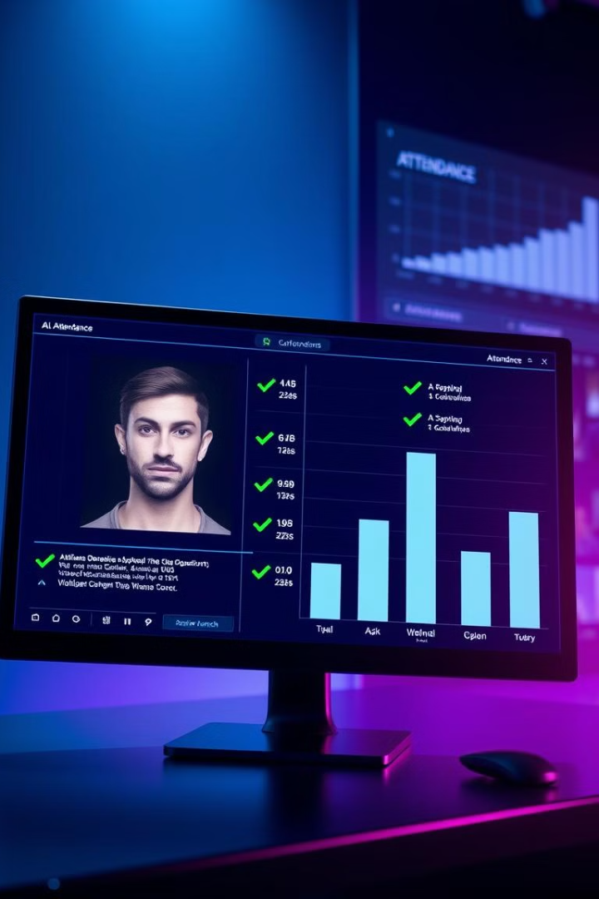
How the System Works
1
The system learns student faces from a photo database.
2
A classroom camera captures images, and the AI detects faces.
3
AI creates unique "face signatures" for each student.
4
The system compares signatures to confirm attendance.

Slide 7





Facial Recognition Technology
Face Detection
Face Recognition
AI precisely locates faces in classroom images.
The system identifies students by matching unique facial features.
AI/Neural Networks
Image Processing
AI learns, improves accuracy, and adapts to conditions.
Enhanced image quality ensures reliable face detection.

Slide 8

Aim: Improving Efficiency and Accuracy
10x
Improved
Faster
Record Management
Attendance takes 10x less time compared to manual methods.
Our system aims to provide significantly better record management compared to manual methods.

Slide 9
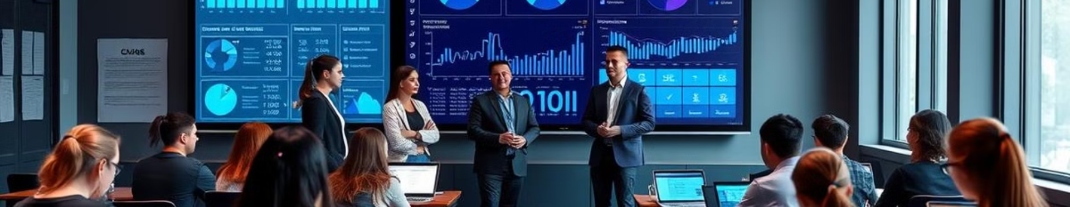
Benefits for Teachers and Students
More Teaching Time
Improved Efficiency
Accurate Data
Teachers gain more time to focus on instruction.
Streamlined attendance improves overall classroom flow.
Reliable attendance records benefit students and teachers.

Slide 10

Next Steps and Conclusion
Our AI attendance solution aims to empower schools to optimize their attendance processes, leading to a more efficient and impactful learning environment.

